Slide 1








IOT ARCHITECTURE
&
CHALLENGES
PREPARED BY
MARIA JAHAN MIM
ID:2101022
PRESENTED TO
MD MASUD RANA
LECTURER,
DEPT. OF CYBER SECURITY ENGINEERING, BDU.

Slide 2
DEFINITION
IoT architecture is the structure that allows for interconnected devices, cloud services and protocols to create an IoT ecosystem. This network consists of smart sensors, actuators and other connected elements that enable data flow from physical sources through networks into storage in the cloud.

Slide 3
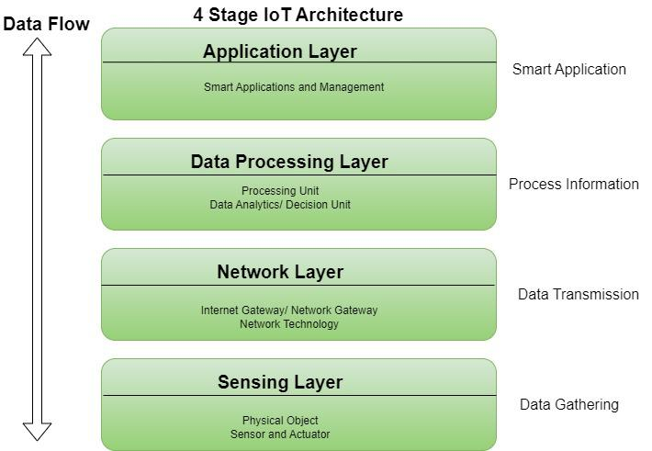
KEY LAYERS OF IOT ARCHITECTURE

Slide 4
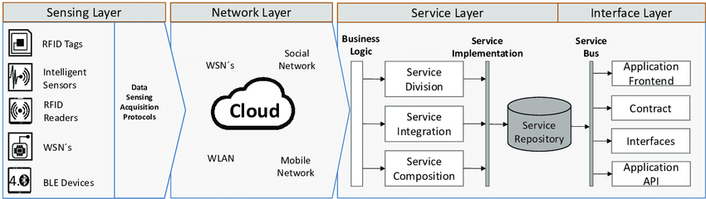
USES TECHNOLOGIES- HTTP, MQTT AND AMQP
HELP BUSINESSES MAKE DECISIONS,
USES ML ALG. FOR AUTOMATED DECISION MAKING. EDGE ANALYTICS
TO FILTER OUT IRRELEVANT OR UNUSABLE DEVICE
A VITAL PLATFORM FOR HUMANS TO INTERACT WITH THE SYSTEM, THIS ALLOWS USERS TO USE THEIR DEVICES CONVENIENTLY, WHETHER IT’S BY TAPPING INTO MOBILE APPS OR USING CENTRALISED DASHBOARDS ON COMPUTERS.
PROVIDE INPUT

Slide 5
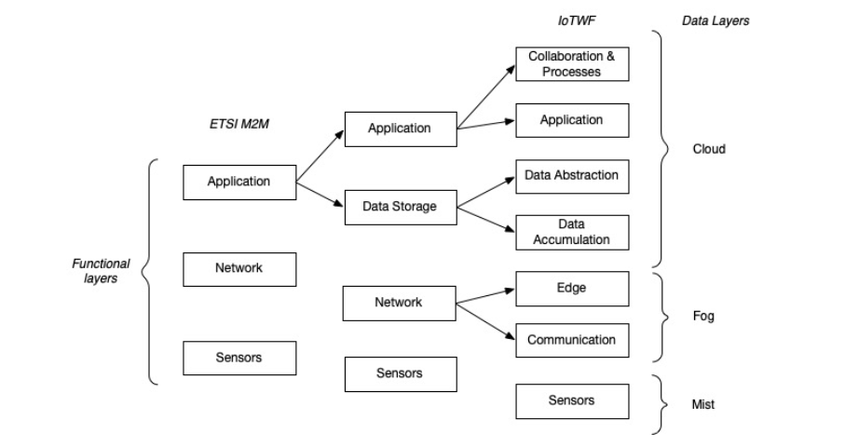
ADDITIONAL COMPONENTS IN IOT ARCHITECTURE

Slide 6
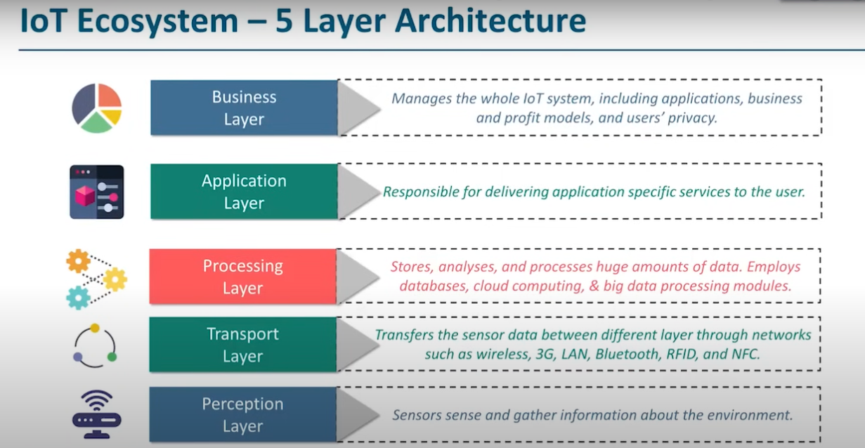

Slide 7
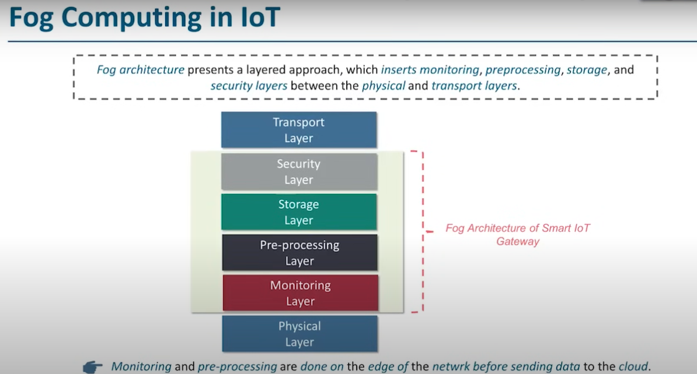

Slide 8
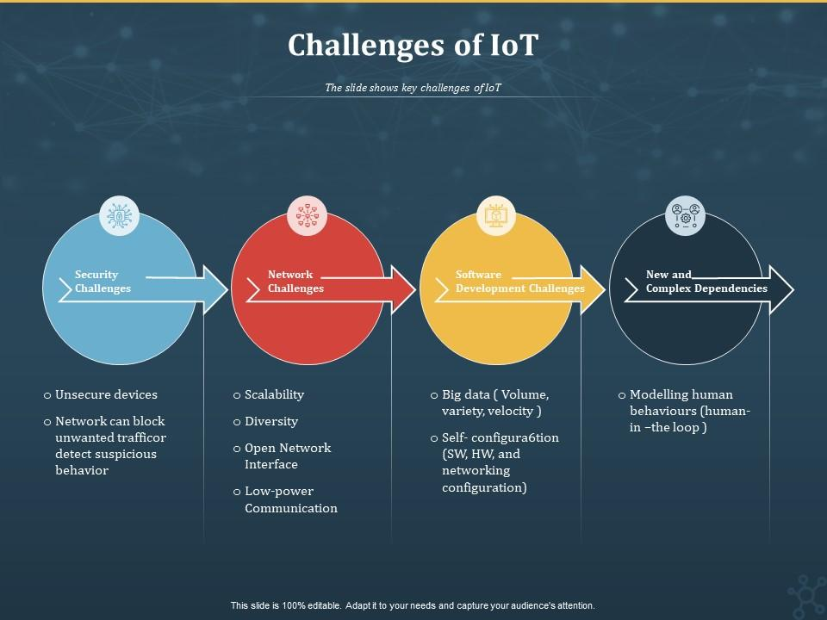

Slide 9
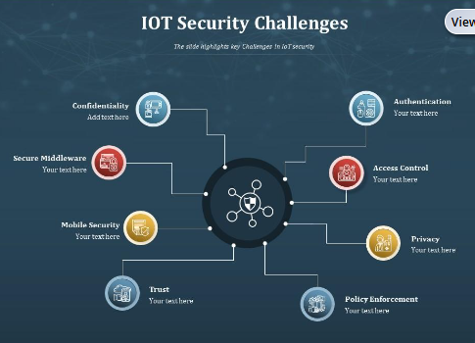

Slide 10
THANK YOU

